Slide 2
Vision
To lead the global product identification industry forward by helping our customers achieve their distinct business goals.
Notes:
Our Vision establishes what kind of company we want to be.
Our vision is to lead the global product identification industry forward by helping our customers achieve their distinct business goals.
What this means:
It’s not about being the biggest. Or having the largest market share. It’s about leading the industry forward. Our customers are continually looking for ways to improve operational productivity (reduce cost) and reliability (uptime), solutions for new materials, and solutions to meet new regulations.
We will continually introduce new, innovative products… new consumables, new service models… new financial models that help solve these problems. We will lead the way, not follow.
Our vision is directly tied to the success of our customers’ businesses and operations. This is critically important. It’s not about what’s best for us, but what’s best for our customers. Each customer has distinct business goals. And they operate differently – often from country to country and sometimes location to location. We are not a generic standard products company. To help our customers achieve their distinct business goals, we will be able to offer the right combination of hardware, software, service and consultation.
And we will do this locally, in each country. That is how we will lead the industry forward.
How to help define the Vision for your Teams:
Lead: Lead, not follow, Innovate and grow
Global: Be successful by leading locally in each country. Win globally by winning locally every week, month, quarter
Product Identification: Variable coding and marking of consumer goods and industrial products, decoration and identification of consumer goods.
(Moving) Industry Forward: Shape the industry by thoroughly understanding and anticipating customer and their customers’ needs, regulations and trends; obligation as market leader to pull our industry forward
Distinct Business Goals: We are not a generic standard products provider. We offer distinct vertical, HW, consumables, SW, service, etc. , advice ….solutions; we offer customizable solutions unique to each customer’s individual requirements. Our work will have a real and tangible impact on our customers’ business; VJ software, Service and Technical Support enable our customer’s to achieve their distinct business goals.

Slide 3
Mission
We partner with our customers to improve their operational reliability and productivity, protect and grow their brands and stay ahead of industry trends and regulations.
We do this as one global team, with passion, integrity, and trust.
Notes:
We do this as one global team. This takes more than the local sales and the global R&D team. It takes our operations teams. It takes our finance team. It takes our manufacturing team. It takes our marketing team. It takes our human resources team. It takes our management team. Around the globe. All working together as one team.
Our teams must ensure that they communicate across locations and across regions. So that if one customer has installed our equipment in one location, we know how it was done and can properly replicate it in another location or region. Or if one customer has set a global strategy, our collective local teams need to be knowledgeable about it to best help them meet their objectives locally.
How to help define the Mission for your Teams:
We partner with our customers. Every Videojet associate enters a covenant with our customers each day. We understand that our customers aren't buyers of equipment but users of our solutions over many years to run their business. This requires that we partner and support them in ways that make the most sense for them during the full lifetime of our solution.
Improve their operational reliability. Must help them continuously improve; help them continuously meet their rigorous demand created by “their customers”
Reliability: Reliability: uptime, predictability; ensure our solution gives them “peace of mind”
Productivity: Our customers’ most important asset. This includes on time delivery, uptime; predictable maintenance and dependability to ensure maximized production efficiencies
Grow their Brands: We must know more than them; obligation as market leaders to prepare our customers for pending shifts in the industry through meeting standards or helping decorate their products to differentiate vs their competition.
We do this with Passion. Our people are passionate; passionate to serve customers, passionate to solve problems that haven’t been solved before; passionate to be individually successful and passionate to help Videojet win in the marketplace.
We do this with Integrity. Our people have the highest level of integrity; always doing what’s in the best interest of the customer; and always being truthful and honest with customers and with coworkers.
And we do this with Trust. Above all, our people will be the most trusted in the industry; trusted for their advice and consultation, trusted for their service, trusted for their honesty, and trusted for their commitment to doing what’s best for their customers’ businesses.

Slide 4
Guiding Principles
We place our customers at the core of everything we do.
Notes:
Key Points to Discuss/Consider:
We have to put the customer first, always.
In order to be a successful company, we must place this principle at the center of all our work and in every customer interaction.
We prove this Principle through our dedication to continually measuring and understanding customer satisfaction and by launching and providing solutions that truly help them achieve their business goals.
We do this through formal or informal VOC, daily interactions, listening, and surveying customer satisfaction.
“Uptime Peace of Mind” is more than a tagline, it is our promise to our customers.
We promise to put their businesses at the core of everything we do.
We promise to find solutions to their challenges and meet their needs, no matter how large or small.

Slide 5
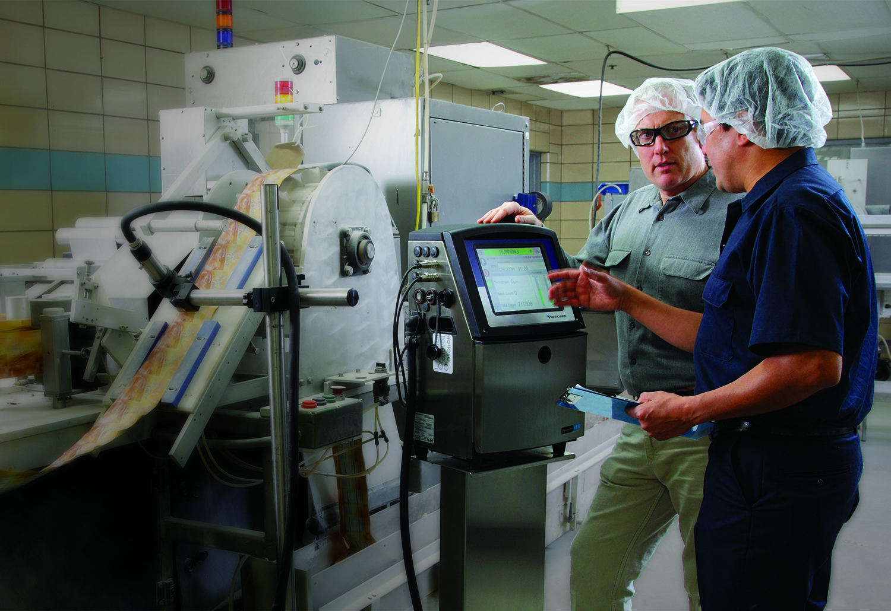
Guiding Principles
We provide partnership and support, helping our customers achieve their operational objectives.
Notes:
Key Points to Discuss/Consider:
We measure our success by our customers’ achieving their goals.
Our customers can not perform their best if we do not provide them with best in class:
Advice (such as application advice on how to address a specific marking and coding need)
Solutions (HW, SW, service, consumables…) that go beyond putting a code on a package
Service and support
Our latest product launch, 1550/1650 CIJ, reflects our efforts to continuously search for ways to provide products that help our customers achieve their goals -- beyond putting the code on the package [note to presenter: please make sure you are fully versed in the 1550/1650 product launch key messages]:
Uptime Advantage. Minimize the frequency and duration of planned and unplanned downtime.
Productivity Tools. Get to the root cause of downtime events – and fix them for good.
The Right Code. Help prevent coding mistakes and make sure the right codes print on the right products.
Simple Operation. Focus more on production, less on user interaction and maintenance.
In service we are constantly measuring our ability to solve any customer problems in the shortest amount of time and fix it right the first time.

Slide 6
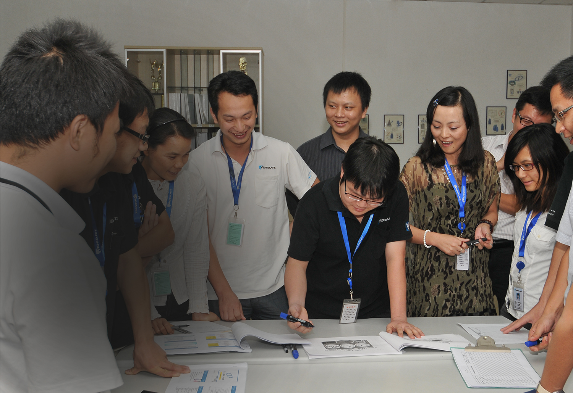
Guiding Principles
We are committed to world-class problem-solving and improving our customers’ businesses.
Notes:
Key Points to Discuss/Consider:
We believe that all current challenges and problems are opportunities.
We embrace challenges and problems and drive strong problem solving to identify how we can help our customers and our own business capture the opportunities.
We must develop an in-depth understand and analyze our customers’ needs, challenges and problems to ensure that we are not only meeting their expressed needs, but surpassing even the unexpressed ones.
We must have strong approaches to problem solving and driving change to capture the opportunities for our customers and our business. And in order to deliver on this, we have a number of tools and approaches that help us succeed no matter the magnitude of the customer’s challenge -- whether short-term such as current production uptime or long-term as in defining, developing and providing them with new innovative solutions that help them achieve their larger business goals.
Problem Solving Process (PSP): Once KPIs are established, this tool helps teams to analyze wins and measure misses. These processes enable you to identify the key reasons for misses and drive change to ensure that the same problem is avoided in the future
DIVE: Define the problem, Investigate the reasons, Verify and Implement the countermeasure and Ensure sustainability
5 Whys: This tool allows employees to establish a set of countermeasures which can help them avoid repeating a customer miss
QDIP: Quality Delivery Inventory Productivity
Daily Management
Policy Deployment (PD)

Slide 7
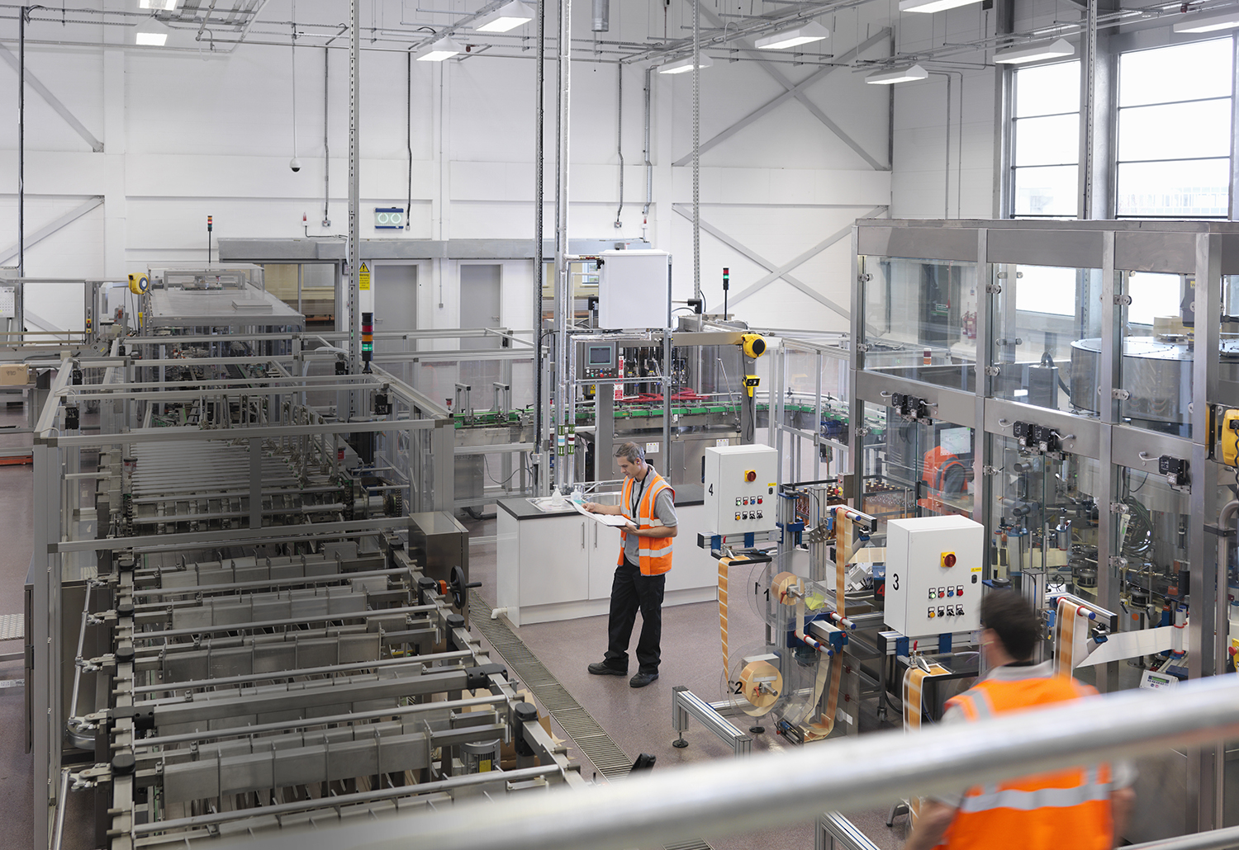
Guiding Principles
We advance our role as experts; we understand the industries we serve and our customers’ needs.
Notes:
Key Points to Discuss/Consider:
We know that in order to understand our customers’ business and operational goals, we must have an in-depth understanding of their
Industries. Regulations, standards, trends, challenges, opportunities
Operations. Manufacturing, quality management and other business processes
We must continuously advance our knowledge of our customers’ industries and operations in our quest to become experts. This allows us to advise customers on how best to achieve their goals and thereby fill their needs.
We have a number of approaches that help us in this endeavor:
Global vertical market penetration program that dives deep into the industries we serve, identifies and documents the industry needs, regulations, standards and trends and then markets to our customers and train our sales and application experts around the world. [note to presenter: please ensure you read up on the VMP program as per the marketing workshops]
Local country efforts to understand local industry trends.
Continuous improvement and lean approaches through DBS that allow us to also work with customers, e.g. marking and coding kaizens and to identify and eliminate waste in their processes and how we can help with their improvement.
Our global reach and broad customer coverage allow us to gain deep insight and the ability to share knowledge, experiences and innovations with our customers.

Slide 8
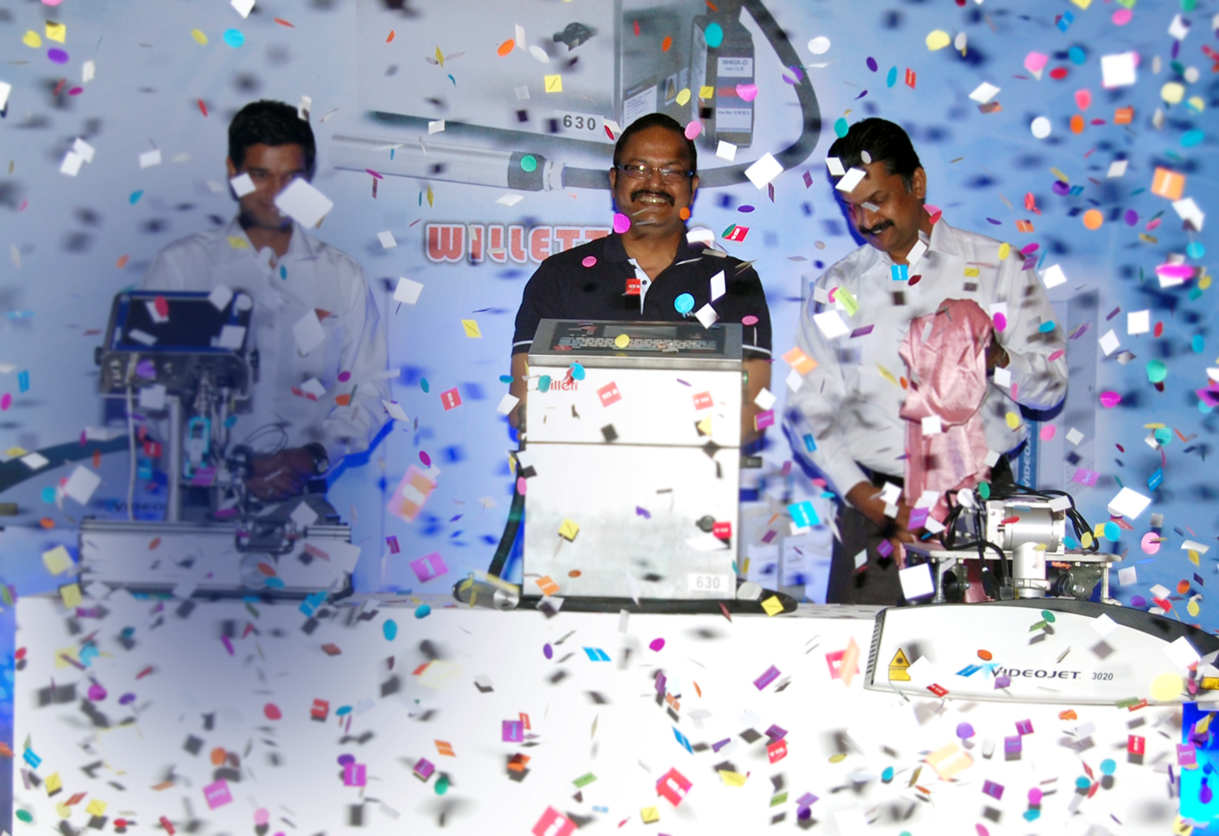
Guiding Principles
We bring our best effort, passion and enthusiasm to everything we do.
Notes:
Key Points to Discuss/Consider:
At Videojet we challenge ourselves to never settle for today.
We are a forward-looking company that has built a foundation on continuous improvement.
We know that we have to compete every day to earn the trust of our customers.
World class solutions and in depth understanding of our customers’ industries and businesses are fundamental.
However, it is our people who make the difference.
We understand that a strong, goal oriented, enthusiastic and passionate team where everyone is engaged can move mountains.
We all believe in
Making our vision and mission something personal for ourselves and not just an empty company slogan.
Working together with everyone bringing their best effort, enthusiasm and passion will not only make our jobs more fun but will also secure the short- and long-term success of our team and company.
Collaborate and innovate on a world-class level to ensure that our customers’ businesses prosper.

Slide 9
The Best Team Wins
Associates are our most valued assets.
Videojet and its associates win because:
We listen to our customers
We focus on results
We seek fact-based, root-cause solutions
We have a bias for improvement
We act with passion, integrity and trust
We have fun (winning is fun!)
Notes:
At Videojet, customers are at our core, but we would not success as a company if we did not have employees like you. Our employees are our best asset. By living the Vision and Mission each day, you are setting yourself up to win. And when you win, Videojet wins!
INSTRUCTIONS: Please read the key points from this slide. Provide examples for each, if available, to shed light on each key idea. It might be appropriate to share how you, as the region manager, will deliver on each of these.

